Slide 1
Cooking with AWS and Splunk
Module 8: Migrating AWS TA between Machines
Kam Amir | Splunk Cloud Architect

Slide 2
Splunk AWS TA REST API
Splunk REST API Tool is found : $SPLUNK_HOME/etc/apps/Splunk_TA_aws/bin/tool/configure
Use README.md for additional help
The Splunk Add-on for AWS contains a REST API which can be used to:
Create New AWS Accounts
Create New AWS Inputs
Create New IAM Roles

Slide 3
Migrating AWS TA using the Config Tool
Setting up Accounts between machines
Collect existing list of accounts
Install fresh TA on new machine
Run Config Command
Validate Update

Slide 4
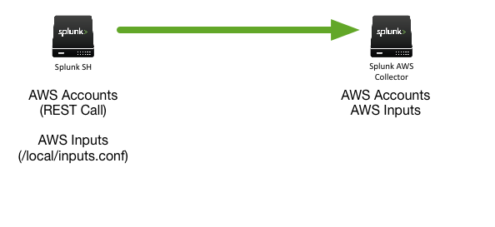
Diagram of Deployment

Slide 5
Collect Existing Account Info
Run search command to collect existing Account information

Slide 6
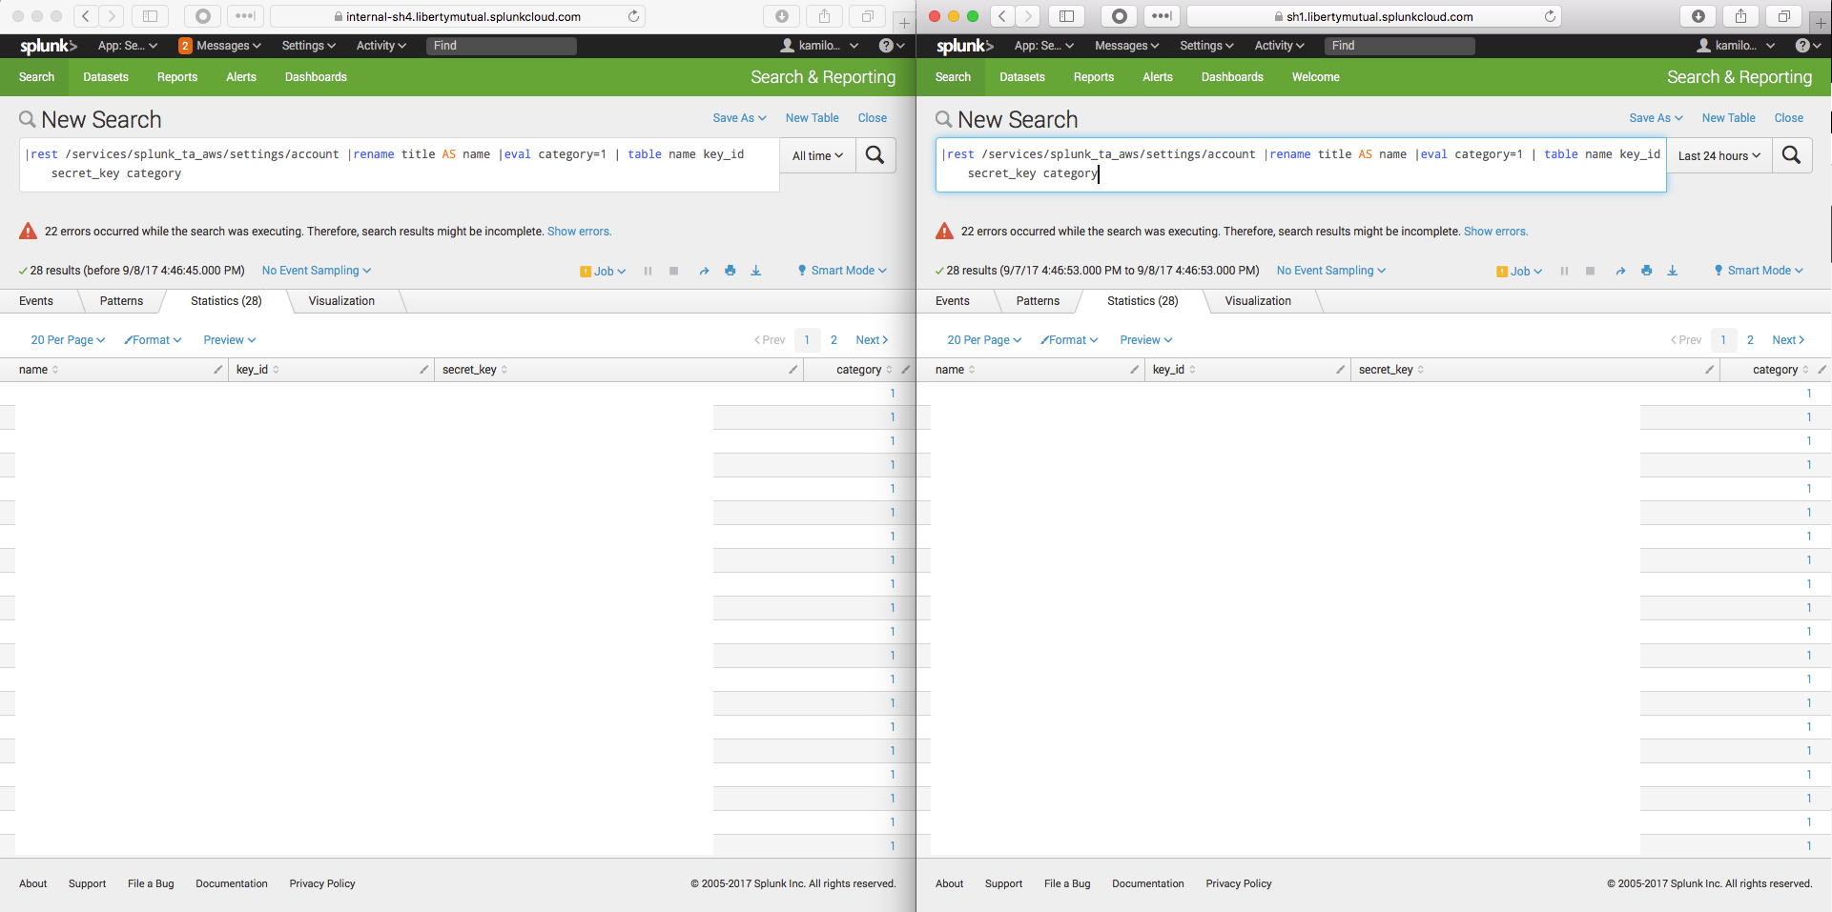
Run Search
|rest /services/splunk_ta_aws/settings/account |rename title AS name |eval category=1 | table name key_id secret_key category

Slide 7
Export Results as JSON
Export Results from Search
Export the results into a JSON formatted file named account-settings.json:
{"name":"aws04splunk","key_id":”SLKDFLKSJDFLKSLDFKJ","secret_key":”0a9df0a9jdfa908j08ajsdofjlksd","category":"1"}
Update the file, remove :
{"preview":false,"result":
{"preview":false,"lastrow":true,"result":

Slide 8
Modify Configuration Files
Add this to the account-settings.json file located in $SPLUNK_HOME/etc/apps/Splunk_TA_aws/bin/tools/configure/config_example
Edit splunk-info.json file to have the proper entry for hostname
Run the command using the splunk python :
bin/splunk cmd python etc/apps/Splunk_TA_aws/bin/tools/configure/aws_config_cli.py account create --hostname localhost --config-file etc/apps/Splunk_TA_aws/bin/tools/configure/config_examples/account-settings-lm.json

Slide 9
Sample Configuration File splunk-info.json
Configuration file is used to log into Splunk’s REST API
[
{
"hostname": "hfw-01",
"mgmt_uri": "https://ghost:8089",
"username": "admin",
"password": "admin"
},
{
"hostname": "hfw-02",
"mgmt_uri": "https://ghost:8089",
"username": "admin",
"password": "admin"
}
]

Slide 10
Sample Configuration File account-settings.json
File used to deploy AWS Accounts onto target machine
[
{
"stanzas":[
{
"name": "aws-account-0",
"key_id": "ABCDEFGHIJKLMNOPQRST",
"secret_key": "ABCDEFGHIJKLMNOPQRSTUVWXYZabcdefghijklmn",
"category": "1"
},
{
"name": "aws-account-1",
"key_id": "abcdefghijklmnopqrst",
"secret_key": "abcdefghijklmnopqrstuvwxyzABCDEFGHIJKLMN",
"category": "1"
}
]
}
]

Slide 11
Additional Searches
Search other REST endpoints
S3 inputs:|rest /services/splunk_ta_aws/inputs/s3 | rename title AS name | table name host_name bucket_name key_name initial_scan_datetime interval sourcetype
CloudTrail Inputs: |rest /services/splunk_ta_aws/inputs/cloudtrail | rename title AS name | table name
Billing: |rest /services/splunk_ta_aws/inputs/billing | rename title AS name | table name bucket_name key_name initial_scan_datetime interval sourcetype
View All the Available Inputs: |rest /services/splunk_ta_aws/inputs

Slide 12
Copy Config Files
Copy over config files from the original SH to the new Collector

Slide 13
Copy over config files
Copy over the config files
Copy the files from the $SPLUNK_HOME/etc/apps/Splunk_TA_aws/local/*.conf to the new machine in the same location.
OLD SH bash$ tar czvf /tmp/inputs.tgz $SPLUNK_HOME/etc/apps/Splunk_TA_aws/local/*.conf
NEW SH
Install AWS TA (fresh install)
Create “local” directory mkdir -p $SPLUNK_HOME/etc/apps/Splunk_TA_aws/local
bash$ scp user@old_sh.splunk.com:/tmp/inputs.tgz $SPLUNK_HOME/etc/apps/Splunk_TA_aws/local
Untar files to local directory: bash$ tar xvf $SPLUNK_HOME/etc/apps/Splunk_TA_/aws/local/inputs.tgz
Restart Splunk

Slide 14
Clean Up Config Files
Be sure to clean up the configuration files with any accounts, usernames and passwords.

Slide 15
Remove the following files
These file contain sensitive information and need to be removed.
Remove files with account information from system:
rm -rf $SPLUNK_HOME/etc/apps/Splunk_TA_aws/bin/tools/configuration/config_examples/account-settings.json
rm -rf $SPLUNK_HOME/etc/apps/Splunk_TA_aws/bin/tools/configuration/splunk-info.json

Slide 16
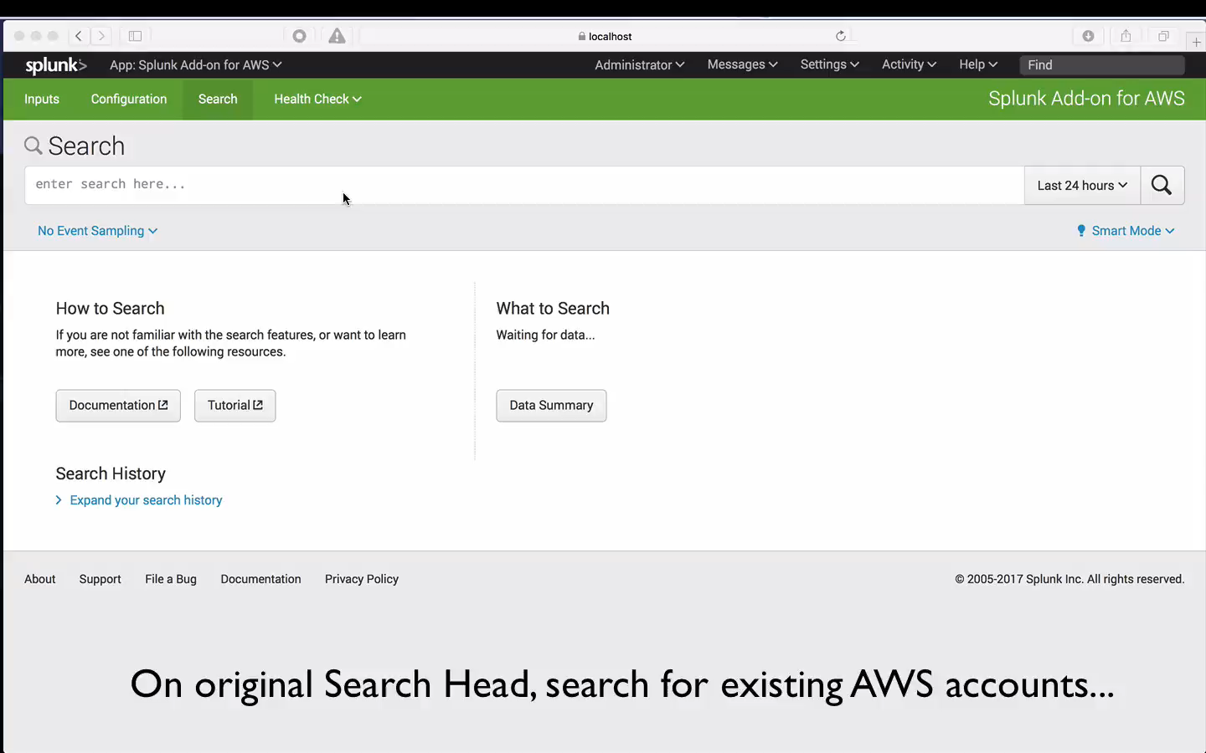
Video of Module 8
End-to-End video for module 8

Slide 17
Continue to Module 9: Setting up Kinesis Firehose

